Slide 1
SPRING WEB MVC FRAMEWORK
Instructor:

Slide 2
Table Content
1
Introduction to Spring Web MVC
2
Spring Autowrite
3
JdbcTemplate
Spring MVC First Example
4

Slide 3
Learning Goals
After the course, attendees will be able to:
Understand Spring Web MVC Framework and its core technologies.
Know how to write a Web application with Spring MVC Framework.

Slide 4
Introduction
Section 1

Slide 5

Introduction to Spring MVC
A part of the Spring Framework is Spring Web MVC, an extensible MVC framework for creating web applications.
Support for Invesrsion of Control (or, the Dependency Injection).
Use DispatcherServlet that dispatches request to handler.
The default handler is based on the @Controller and @RequestMapping annotations.
Notes:
Spring Framework ra xuất phát từ sự thành công của EJB (Enterprise JavaBean)- một kiến trúc phát triển dành cho các ứng dụng doanh nghiệp có tính mở rộng cao;
Phát triển năm 2002 bởi Rod Johnson. J2EE Development without EJB
Theo một số nguồn, trên 50% các ứng dụng web Java hiện nay đang sử dụng Spring.
Đơn giản hóa công việc phát triển thông qua việc sử dụng các đối tượng Java đơn giản hay còn được gọi là POJO (Plain Old Java Object)
Sử dụng DI và interface;
Sử dụng convention và aspect (quy tắc chung);
One of the chief advantages of the Spring framework is its layered architecture.
You can be selective about which of its components you use while also providing a cohesive framework for J2EE application development

Slide 6
An Introduction to MVC
A Web Application developed using JSP/Servlet Technology:
Model: presents Data;
View: presents UI part;
Controller: manages the application flow, makes a call to some sort of service producting Model and then passes on the Model to the View;

Slide 7
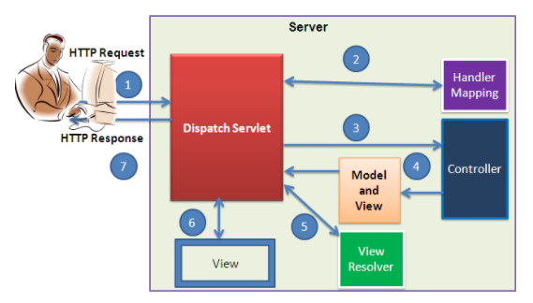
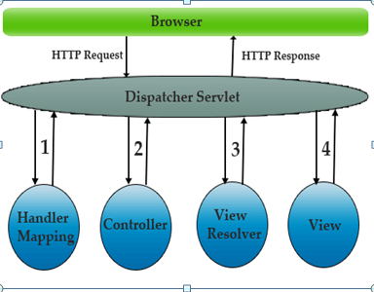
An Introduction to MVC
A Web Application developed using SpringMVC framework:

Slide 8
Spring MVC Processing Sequence
Step1
Client sends HTTP Request from the web browser to server. Inside the Web or Application server, Dispatch Servlet will be there to handle your Http request and Processed HTTP Response.
Step2
Handler Mapping Maps incoming HTTP Requests to handlers, In spring MVC framework we use @Request Mapping annotation to map the incoming Http Request with Model and View Object inside the controller class.
Step3
Controller class in spring is implemented with the help of @Controller Annotation, which does model Map with data and extracting a view name, it can also send directly as HTTP response without mapping the incoming request with model data object.
The Controller class has ModelAndView objectthat has the model or Data and the view name, the Controller class executes the incoming request by calling the respective service method and returns ModelAndView Object to DispatcherServlet.
Step4
The DispatcherServlet will send the view name to a ViewResolver to find the original View (.jsp) page to display.
Step5
The DispatcherServlet will then send the model object to View in order to render the result.
Step6
The view (.jsp) page will show the HTTP Response back to Client on the web browser.
Step7
Notes:
DispatchServlet works as a Front Controller Design Pattern for the client browser HTTP Request and HTTP Response from server.

Slide 9
DispatcherServlet
What is DispatcherServlet?
is Servlet
Is designed around a central Servlet that dispatches the request to the controller and offers functionality that facilitates the development of web applications.
DispatcherServlet
Is completely integrated with the Spring IoC container and as such allows you to use every other feature that Spring has.

Slide 10
DispatcherServlet
Configuration of DispatcherServlet in web.xml
<web-app xmlns:xsi="http://www.w3.org/2001/XMLSchema-instance"
xmlns="http://java.sun.com/xml/ns/javaee"
xsi:schemaLocation="http://java.sun.com/xml/ns/javaee http://java.sun.com/xml/ns/javaee/web-app_3_0.xsd"
version="3.0">
<display-name>Archetype Created Web Application</display-name>
<welcome-file-list>
<welcome-file>/views/login.jsp</welcome-file>
</welcome-file-list>
<servlet>
<servlet-name>spring</servlet-name>
<servlet-class>org.springframework.web.servlet.DispatcherServlet
</servlet-class>
<load-on-startup>1</load-on-startup>
</servlet>
<servlet-mapping>
<servlet-name>spring</servlet-name>
<url-pattern>/</url-pattern>
</servlet-mapping>
</web-app>

Slide 11
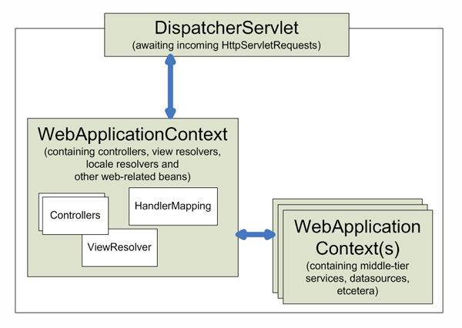
DispatcherServlet
In the Web MVC framework, each DispatcherServlet has its own WebApplicationContext, which inherits all the beans already defined in the root WebApplicationContext.

Slide 12
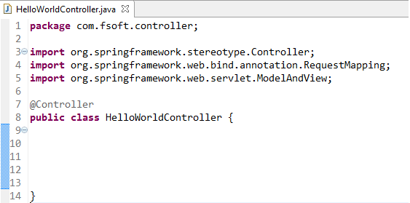
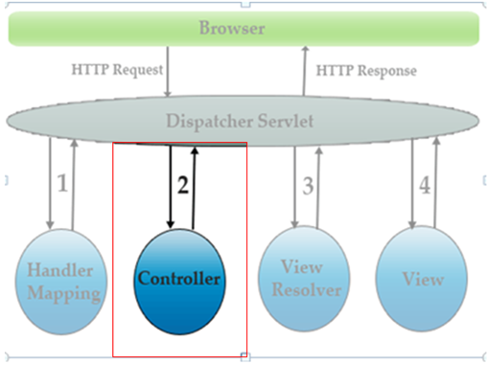
Implementing Controllers
Defining a controller with @Controller
The @Controller annotation indicates that a particular class serves the role of a controller.
The @Controller annotation acts as a stereotype for the annotated class, indicating its role. The dispatcher scans such annotated classes for mapped methods and detects @RequestMapping annotations

Slide 13

Implementing Controllers
Mapping Requests With @RequestMapping
Use the @RequestMapping annotation to map URLs such as /appointments onto an entire class or a particular handler method.

Slide 14
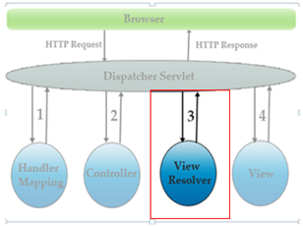
Resolving Views
There are 2 interfaces that are important to the way Spring handle views: ViewResolver and View.
The ViewResolver provides a mapping between view names and actual views.
The View interface addresses the preparation of the request and hands the request over to one of the view technologies.

Slide 15
Resolving Views
Resolving views with the ViewResolver interface:
Spring Web MVC controllers resolves logical view name either explicitly (e.g., by returning a String, View, or ModelAndView) or implicitly (i.e., based on conventions). In Spring, 'logical view name' represents Views and it is resolved by a view resolver.

Slide 16
Resolving Views
Resolving views with the ViewResolver interface:
Given below the list of view resolvers in Spring:
ViewResolver | Description
AbstractCachingViewResolver | This view resolver caches views.
XmlViewResolver | This view resolver uses configuration file written in XML for view resolution.
ResourceBundleViewResolver | This view resolver use ResourceBundle, represented by bundle base name, to resolve view. Generally bundle is defined in a properties file, situated in the classpath.
UrlBaseViewResolver | This view resolver uses “logical view name” returned to find actual view.
InternalResourceViewResolver | This view resolver is the subclass of UrlBasedViewResolver and also support InternalResourceView and also subclass such as JstlView and TilesView.

Slide 17
Resolving Views
Resolving views with the ViewResolver interface:
Given below the list of view resolvers in Spring:
ViewResolver | Description
VelocityViewResolver/ FreeMarkerViewResolver | This view resolver is the subclass of UrlBasedViewResolver which supports VelocityView, FreeMarkerView and its custom subclass.
ContentNegotiatingViewResolver | This view resolver is the implementation of the ViewResolver interface which resolves view on the basis of request file name or Accept header

Slide 18
Resolving Views
Create spring-servlet.xml under the src/main/webapp/WEB-INF folder and define the beans.
Example : Configuration for InternalResourceViewResolver
Example : Configuration for TilesViewResolver
<bean id="viewResolver"
class="org.springframework.web.servlet.view.InternalResourceViewResolver">
<property name="prefix" value="/views/" />
<property name="suffix" value=".jsp" />
</bean>
<bean id="viewResolver"
class="org.springframework.web.servlet.view.tiles3.TilesViewResolver">
<property name="viewClass">
<value>
org.springframework.web.servlet.view.tiles3.TilesView
</value>
</property>
</bean>

Slide 19
Resolving Views: XmlViewResolver
XmlViewResolver is used to resolve “view name” based on view beans in the XML file.
By default, XmlViewResolver will loads the view beans from /WEB-INF/views.xml.
This location can be overridden through the “location” property,
File spring-servlet.xml:
<bean class="org.springframework.web.servlet.view.XmlViewResolver">
<property name="location">
<value>/WEB-INF/spring-views.xml</value>
</property>
</bean>

Slide 20
Resolving Views: Controller
A controller class, returns a view, named “WelcomePage“.
public class WelcomeController extends AbstractController{
@Override
protected ModelAndView handleRequestInternal(
HttpServletRequest request,HttpServletResponse response)
throws Exception {
ModelAndView model = new ModelAndView("WelcomePage");
return model;
}
}

Slide 21
Resolving Views: XmlViewResolver
The “view bean” is just a normal Spring bean declared in the Spring’s bean configuration file, where
“id” is the “view name” to resolve.
“class” is the type of the view.
“url” property is the view’s url location.
File : spring-views.xml
<bean id="WelcomePage“
class="org.springframework.web.servlet.view.JstlView">
<property name="url" value="/WEB-INF/pages/WelcomePage.jsp" />
</bean>

Slide 22
Resolving Views: ResourceBundleViewResolver
ResourceBundleViewResolver is used to resolve “view named” based on view beans in “.properties” file.
By default, ResourceBundleViewResolver will loads the view beans from file views.properties
This location can be overridden through the “basename” property.
File spring-servlet.xml:
<bean class="org.springframework.web.servlet.view.
ResourceBundleViewResolver">
<property name="basename" value= "spring-views" />
<property name="order" value="0" />
</bean>

Slide 23
Resolving Views: Controller
A controller class, returns a view, named “WelcomePage“.
public class WelcomeController extends AbstractController{
@Override
protected ModelAndView handleRequestInternal(
HttpServletRequest request,HttpServletResponse response)
throws Exception {
ModelAndView model = new ModelAndView("WelcomePage");
return model;
}
}

Slide 24
Resolving Views: ResourceBundleViewResolver
Declare each view bean as a normal resource bundle style (key & message), where
“WelcomePage” is the view name to match.
“.(class)” is the type of view.
“.url” is the view’s URL location.
File spring-views.properties:
course_list.(class) = org.springframework.web.servlet.view.JstlView
course_list.url = /views/pages/course_list.jsp
WelcomePage.(class) = org.springframework.web.servlet.view.JstlView
WelcomePage.url = /views/pages/WelcomePage.jsp

Slide 25
Spring MVC Autowire
Section 2

Slide 26
Spring MVC Autowire
Spring @Autowired annotation is used for autowiring a bean to constructor, setter method, property or methods.
Following are the different ways we can do autowire feature:
Auto-Wiring "no"
This is default mode means no autowiring
Auto-Wiring "byName"
This means autowiring happens using the matching property name
Auto-Wiring "byType"
This means autowiring happens using the matching type
Auto-Wiring "constructor"
This means autowiring happens through constructor according to the exact arguments

Slide 27
Spring MVC Autowire
With Standard code:
AddressController
AddressServiceImpl
------
+ getAllAddress()
AddressService
------
+ getAllAddress()
public class AddressController {
private AddressService addressService = new AddressServiceImpl();
public List<Address> getAllAddress(){
return addressService.getAllAddress();
}
}

Slide 28
Spring MVC Autowire
With Autowire:
We are defining a new bean "addressService" inside spring-servlet.xml:
AddressController
AddressServiceImpl
------
+ getAllAddress()
AddressService
------
+ getAllAddress()
<context:component-scan base-package="com.fsoft" />
<context:annotation-config />
<mvc:annotation-driven />
<bean id=“addressService" class="com.fsoft.services.AddressServiceImpl" />
</beans>

Slide 29
Spring MVC Autowire
With Autowire:
AddressController
AddressServiceImpl
------
+ getAllAddress()
AddressService
------
+ getAllAddress()
@Controller
public class AddressController {
@Autowired
private AddressService addressService;
@RequestMapping(value="/addressList", method= RequestMethod.GET)
public String getAllAddress(ModelMap modelMap){
List<Address> listOfAddress = addressService.getAllAddress();
modelMap.addAttribute("addresses", listOfAddress);
return "address_list";
}
}

Slide 30
Spring JdbcTemplate
Section 3

Slide 31
Spring JdbcTemplate
Spring JdbcTemplate is a powerful mechanism to connect to the database and execute SQL queries.
Problems of JDBC API:
We need to write a lot of code before and after executing the query, such as creating connection, statement, closing resultset, connection etc.
We need to perform exception handling code on the database logic.
We need to handle transaction.
Repetition of all these codes from one to another database logic is a time consuming task.

Slide 32
Spring Jdbc Approaches
Spring framework provides following approaches for JDBC database access:
JdbcTemplate
NamedParameterJdbcTemplate
SimpleJdbcTemplate
SimpleJdbcInsert and SimpleJdbcCall

Slide 33
JdbcTemplate class
It is the central class in the Spring JDBC support classes.
It takes care of creation and release of resources such as creating and closing of connection object etc. So it will not lead to any problem if you forget to close the connection.
It handles the exception and provides the informative exception messages by the help of excepion classes defined in the org.springframework.dao package.
We can perform all the database operations by the help of JdbcTemplate class such as insertion, updation, deletion and retrieval of the data from the database.
Let's see the methods of spring JdbcTemplate class.

Slide 34
JdbcTemplate class
Method | Description
public int update(String query) | is used to insert, update and delete records.
public int update(String query, Object... args) | is used to insert, update and delete records using PreparedStatement using given arguments.
public void execute(String query) | is used to execute DDL query.
public T execute(String sql, PreparedStatementCallback action) | executes the query by using PreparedStatement callback.
public T query(String sql, ResultSetExtractorrse) | is used to fetch records using ResultSetExtractor.
public List query(String sql, RowMapper rse) | is used to fetch records using RowMapper.

Slide 35
DriverManagerDataSource class
The DriverManagerDataSource is used to contain the information about the database such as driver class name, connnection URL, username and password.
Need to provide the reference of DriverManagerDataSource object in the JdbcTemplate class for the datasource property.
Declare datasource bean:
<bean id="jdbcTemplate" class="org.springframework.jdbc.core.JdbcTemplate">
<property name="dataSource" ref="dataSource" />
</bean>
<bean id="dataSource"
class="org.springframework.jdbc.datasource.DriverManagerDataSource">
<property name="driverClassName“
value="com.microsoft.sqlserver.jdbc.SQLServerDriver" />
<property name="url"
value="jdbc:sqlserver://1WDDIEUNT1-LT:1433;databaseName=FAMS" />
<property name="username" value="sa" />
<property name="password" value="12345678" />
</bean>

Slide 36
Spring MVC First Example
Section 4

Slide 37
Spring MVC First Example
There are given 5 steps for creating the spring MVC application. The steps are as follows:
Create the request /respone pages
Create the bean/controller/service/dao class
Provide the entry of controller in the web.xml file
Define the bean in the xml file
Start server and deploy the project

Slide 38
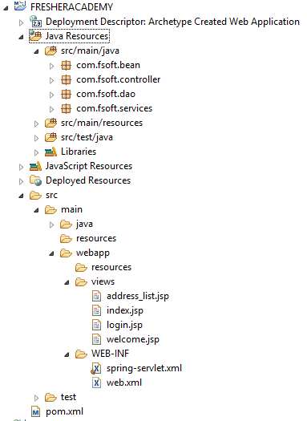
Directory Structure using Maven

Slide 39
Required Maven Dependency
Add maven dependency in pom.xml file.
<project ...>
<properties>
<project.build.sourceEncoding>UTF-8
</project.build.sourceEncoding>
<spring.version>4.3.10.RELEASE</spring.version>
<junit.version>4.12</junit.version>
<servlet.version>3.1.0</servlet.version>
</properties>
<dependencies>
<!-- Junit -->
<dependency>
<groupId>junit</groupId>
<artifactId>junit</artifactId>
<version>${junit.version}</version>
<scope>test</scope>
</dependency>
<!--Servlet-Api -->
<dependency>
<groupId>javax.servlet</groupId>
<artifactId>javax.servlet-api</artifactId>
<version>${servlet.version}</version>
</dependency>
<!-- Spring Framework -->
<dependency>
<groupId>org.springframework</groupId>
<artifactId>spring-core</artifactId>
<version>${spring.version}</version>
</dependency>
<dependency>
<groupId>org.springframework</groupId>
<artifactId>spring-beans</artifactId>
<version>${spring.version}</version>
</dependency>
<dependency>
<groupId>org.springframework</groupId>
<artifactId>spring-context</artifactId>
<version>${spring.version}</version>
</dependency>
<dependency>
<groupId>org.springframework</groupId>
<artifactId>spring-webmvc</artifactId>
<version>${spring.version}</version>
</dependency>

Slide 40
Required Maven Dependency
Add maven dependency in pom.xml file.
<!-- Spring JDBC -->
<dependency>
<groupId>org.springframework</groupId>
<artifactId>spring-jdbc</artifactId>
<version>${spring.version}</version>
</dependency>
<!-- JSTL -->
<dependency>
<groupId>javax.servlet</groupId>
<artifactId>jstl</artifactId>
<version>1.2</version>
</dependency>
<!-- MS SQL Server -->
<dependency>
<groupId>com.microsoft.sqlserver</groupId>
<artifactId>mssql-jdbc</artifactId>
<version>6.1.0.jre7</version>
</dependency>
</dependencies>
<build>
<finalName>FRESHERACADEMY</finalName>
</build>
</project>

Slide 41
Table definition
We are assuming that you have created the following table inside the FAMS database.
CREATE TABLE [dbo].[Users](
[user_id] [int] IDENTITY(1,1) PRIMARY KEY NOT NULL,
[user_name] [varchar](50) NOT NULL,
[email] [varchar](50) NOT NULL,
[password] [varchar](50) NOT NULL,
[enabled] TINYINT NOT NULL DEFAULT 1
)

Slide 42
(1) Create the request/respone pages
Create login.jsp:
And index.jsp:
<body>
<form action="login" method="post" name="loginForm">
User Name: <input type="text" name="userName">
Password: <input type="password" name="password">
<input type="submit" value="Login">
</form>
</body>
<body>
<h2>Welcome <span>${userName}</span>! </h2>
</body>
</html>

Slide 43
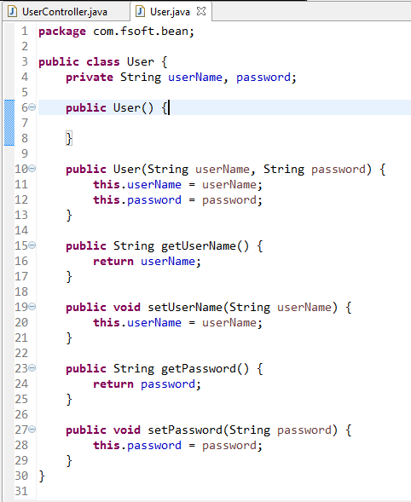
(2) Create the bean class

Slide 44
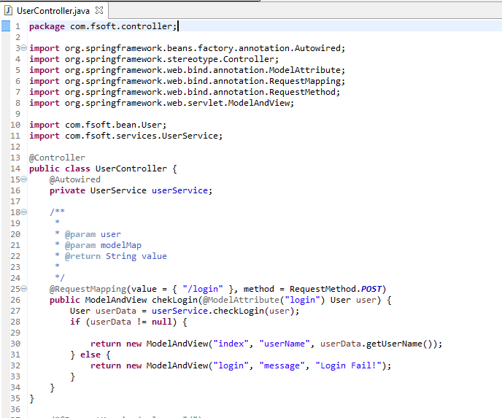
(2) Create the controller class
Notes:
/**
*
* @param user
* @param modelMap
* @return String value
*
*/
@RequestMapping(value = { "/login" }, method = RequestMethod.POST)
public ModelAndView chekLogin(@ModelAttribute("user") User user) {
User userData = userService.checkLogin(user);
if (userData != null) {
return new ModelAndView("index", "userName", userData.getUserName());
} else {
return new ModelAndView("login", "message", "Login Fail!");
}
}

Slide 45
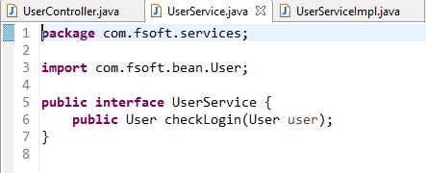
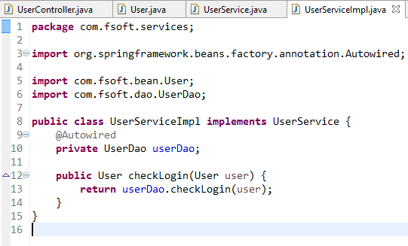
(2) Create the service class

Slide 46
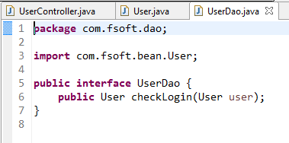
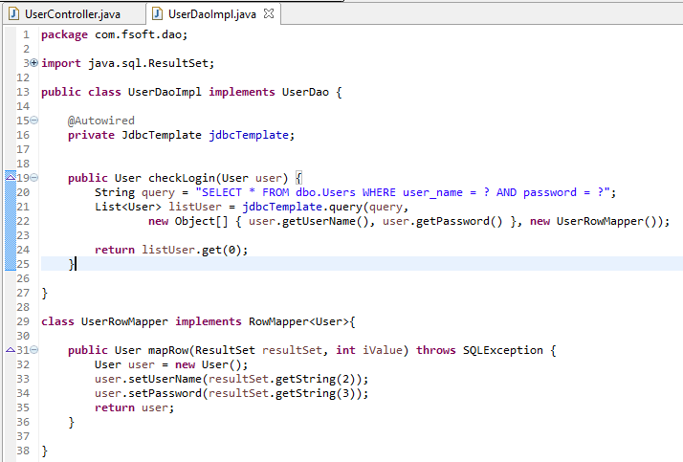
(2) Create the dao class
Notes:
package com.fsoft.dao;
import java.sql.ResultSet;
import java.sql.SQLException;
import java.util.List;
import org.springframework.beans.factory.annotation.Autowired;
import org.springframework.jdbc.core.JdbcTemplate;
import org.springframework.jdbc.core.RowMapper;
import com.fsoft.bean.User;
public class UserDaoImpl implements UserDao {
@Autowired
private JdbcTemplate jdbcTemplate;
public User checkLogin(User user) {
String query = "SELECT * FROM dbo.Users WHERE user_name = ? AND password = ?";
List<User> listUser = jdbcTemplate.query(query,
new Object[] { user.getUserName(), user.getPassword() }, new UserRowMapper());
return listUser.get(0);
}
}
class UserRowMapper implements RowMapper<User>{
public User mapRow(ResultSet resultSet, int iValue) throws SQLException {
User user = new User();
user.setUserName(resultSet.getString(2));
user.setPassword(resultSet.getString(3));
return user;
}
}

Slide 47
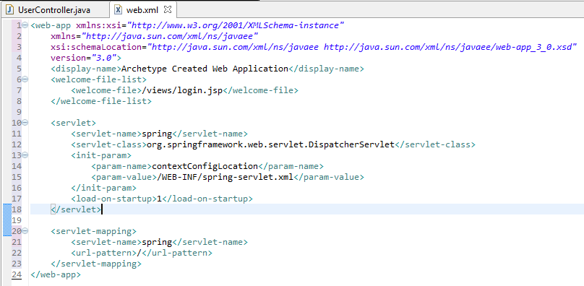
(3) Provide the entry of controller in the web.xml file

Slide 48
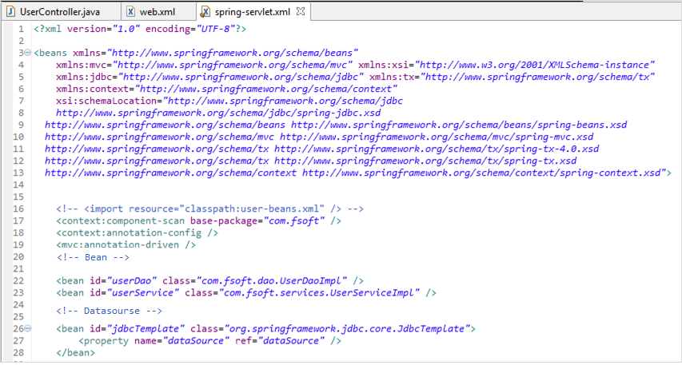
(4) Define the bean in the xml file
Create spring-servlet.xml under the src/main/webapp/WEB-INF folder and define the beans.

Slide 49
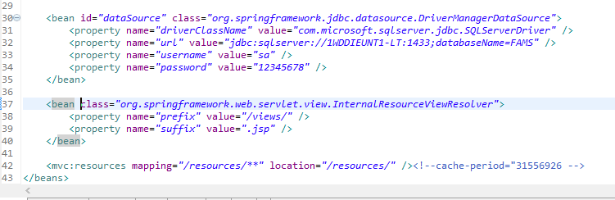
(4) Define the bean in the xml file

Slide 50
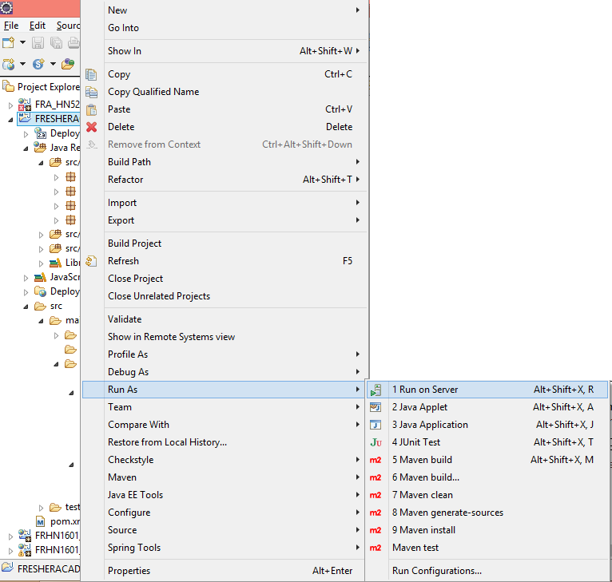
(5) Start server and deploy the project

Slide 51
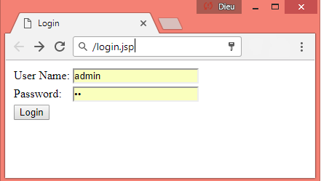
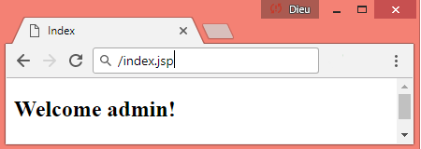
(5) Start server and deploy the project

Slide 52
SUMMAY
1
Introduction to Spring Web MVC
2
Spring Autowrite
3
JdbcTemplate
Spring MVC First Example
4

Slide 53

Thank you
53

